Slide 1
CSYE 7374
Design Patterns
Notes:
1.001

Slide 2
Facade Design Patterns
Daniel Peters
d.peters@neu.edu

Slide 3
Lecture
UML
Design Patterns:
Gang of Four (GoF)
Façade Pattern

Slide 4
Relationships
5/21/2020
Association
Aggregation
“Has-A”
Composition
“Has-A”
Generalization
Inheritance
“Is-A”

Slide 5
Association Relationship
5/21/2020
Association: Has-A Relationship
Aggregation
Weak association: linked but independent objects
possessed object can survive after possessing object
Line with open arrowhead outline
Composition
Strong association: linked objects are dependent
possessed object is destroyed along with possessing object
Line with solid filled-in arrowhead

Slide 6
Aggregation Association Relationship
1..*
1
10..*
1
1
1
6/12/2020
Weak Independent Aggregation Association
Teacher Classroom
Student School
Driver Automobile
Teachers can continue to exist without Classroom
Student existence independent of School
Driver can get another Automobile

Slide 7
Composition Association Relationship
2
1
1
1
1
1
6/12/2020
Strong Dependent Composition Association
Eyes Body
State Context
AutoState Automobile
The Automobile State (AutoState) is dependent on existence of the Automobile

Slide 8
Relationships
9/7/2015
Generalization
Parent
Child

Slide 9
UML Class Diagram
Class
Attributes
Operations
9/7/2015

Slide 10
UML Class Diagram
ClassName
- private
- Attribute1 : int
- Attribute2 : String
+ public
+ Operation1() : int
+ Operation2(int) : void
9/7/2015

Slide 11
Person Class Diagram
Person
- age : int
- name : String
+ setAge(int) : void
+ getAge() : int
+ setName(String) : void
+ getName() : String
Employee
Student
- hours: int
- grade : int
+ setHours(int) : void
+ getHours() : int
+ setGrade(int) : void
+ getGrade() : int
9/7/2015

Slide 12
Facade Class Diagram
Facade
Subsystem1
Subsystem2
9/7/2015

Slide 13
Design Patterns
Gang of Four (GoF) Book
Design Patterns
Elements of Reusable Object-Oriented Software
by Erich Gamma, Richard Helm, Ralph Johnson John Vlissides
ISBN-10: 0201633612
ISBN-13: 9780201633610

Slide 14
Structural Design Patterns
Class object relationships and interaction
How classes and objects are composed to form larger structures
Make independently developed classes work together
Gang of Four (GoF) Book

Slide 15
Structural Design Patterns
Structural class patterns
Use Inheritance e.g., Adapter pattern
Structural object patterns
Use Object composition e.g., Facade pattern
Gang of Four (GoF) Book

Slide 16
Structural Design Patterns
Describes ways to compose objects to realize new functionality
Changing object composition at run-time is a flexibility impossible with static class composition
Gang of Four (GoF) Book

Slide 17
Facade Design Pattern
Façade Pattern is a Structural Pattern in GoF Design Patterns Book:
“Provide a unified interface to a set of interfaces in a subsystem. Facade defines a higher-level interface that makes the subsystem easier to use,"
Knows subsystems responsibility
Delegates requests to appropriate subsystem
API Simplifier by Grouping
Gang of Four (GoF) Book

Slide 18
Facade Design Pattern
Anatomy of a Design Pattern
Who (are): Constituent Components (parts)
What (happens): Operational
Where (useful): Scenarios
Why (design) Rationale
When (used): Benefits

Slide 19
Facade Design Pattern
Who:
Constituent components, roles or parts participating in the deployment and use of the Facade pattern
Facade
Is the Client interface
Handles all requests using the appropriate subsystem
One Simplified interface unifying all subsystems
Subsystem classes and objects
Provides the functionality
Performs work requested of Facade
Façade is anonymous: subsystem has no reference to it

Slide 20
Facade Design Pattern
What:
A brief description of what happens with the use of the Facade pattern
Client sends requests to Facade instead of directly to each subsystem
Simplified request
Facade forwards requests to the appropriate subsystem on behalf of the Client
Facade manages complexity of subsystem requests
Facade provides loose coupling to subsystems

Slide 21
Facade Design Pattern
Where:
A list of suitable scenarios for the use of the Facade pattern
Façade pattern works well where (1 or more of the following):
Complex interface needs simplification
Make complex procedural interface easy to use and useful
Make many subsystems look like one
Provide greater abstraction between Client and Subsystems for loose coupling

Slide 22
Facade Design Pattern
Why:
A brief description of rationale behind the design of the Facade pattern
Subsystems are a good design choice for reducing overall complexity
A Single Simplified Unified interface provided by a Façade is a easy to use alternative to the more general and complex direct interface to the various subsystems

Slide 23
Facade Design Pattern
When:
A brief description of the benefits obtained when using the Facade pattern
Abstraction: hides subsystem components
Simplification achieved while promoting loose coupling
Flexibility: direct use of subsystem classes by Client is still available when needed.
Façade simplified interface is available
Original complex general subsystem interface remains available

Slide 24
Facade Pattern
5/11/2020
Implements a higher-level API
Abstracts a more complex lower level API
Hides clients from complex subsystem details
A Single Simplified Unified Interface
API Simplifier

Slide 25
Summary: Facade Pattern
Facade: API Simplifier
Structural Pattern

Slide 26
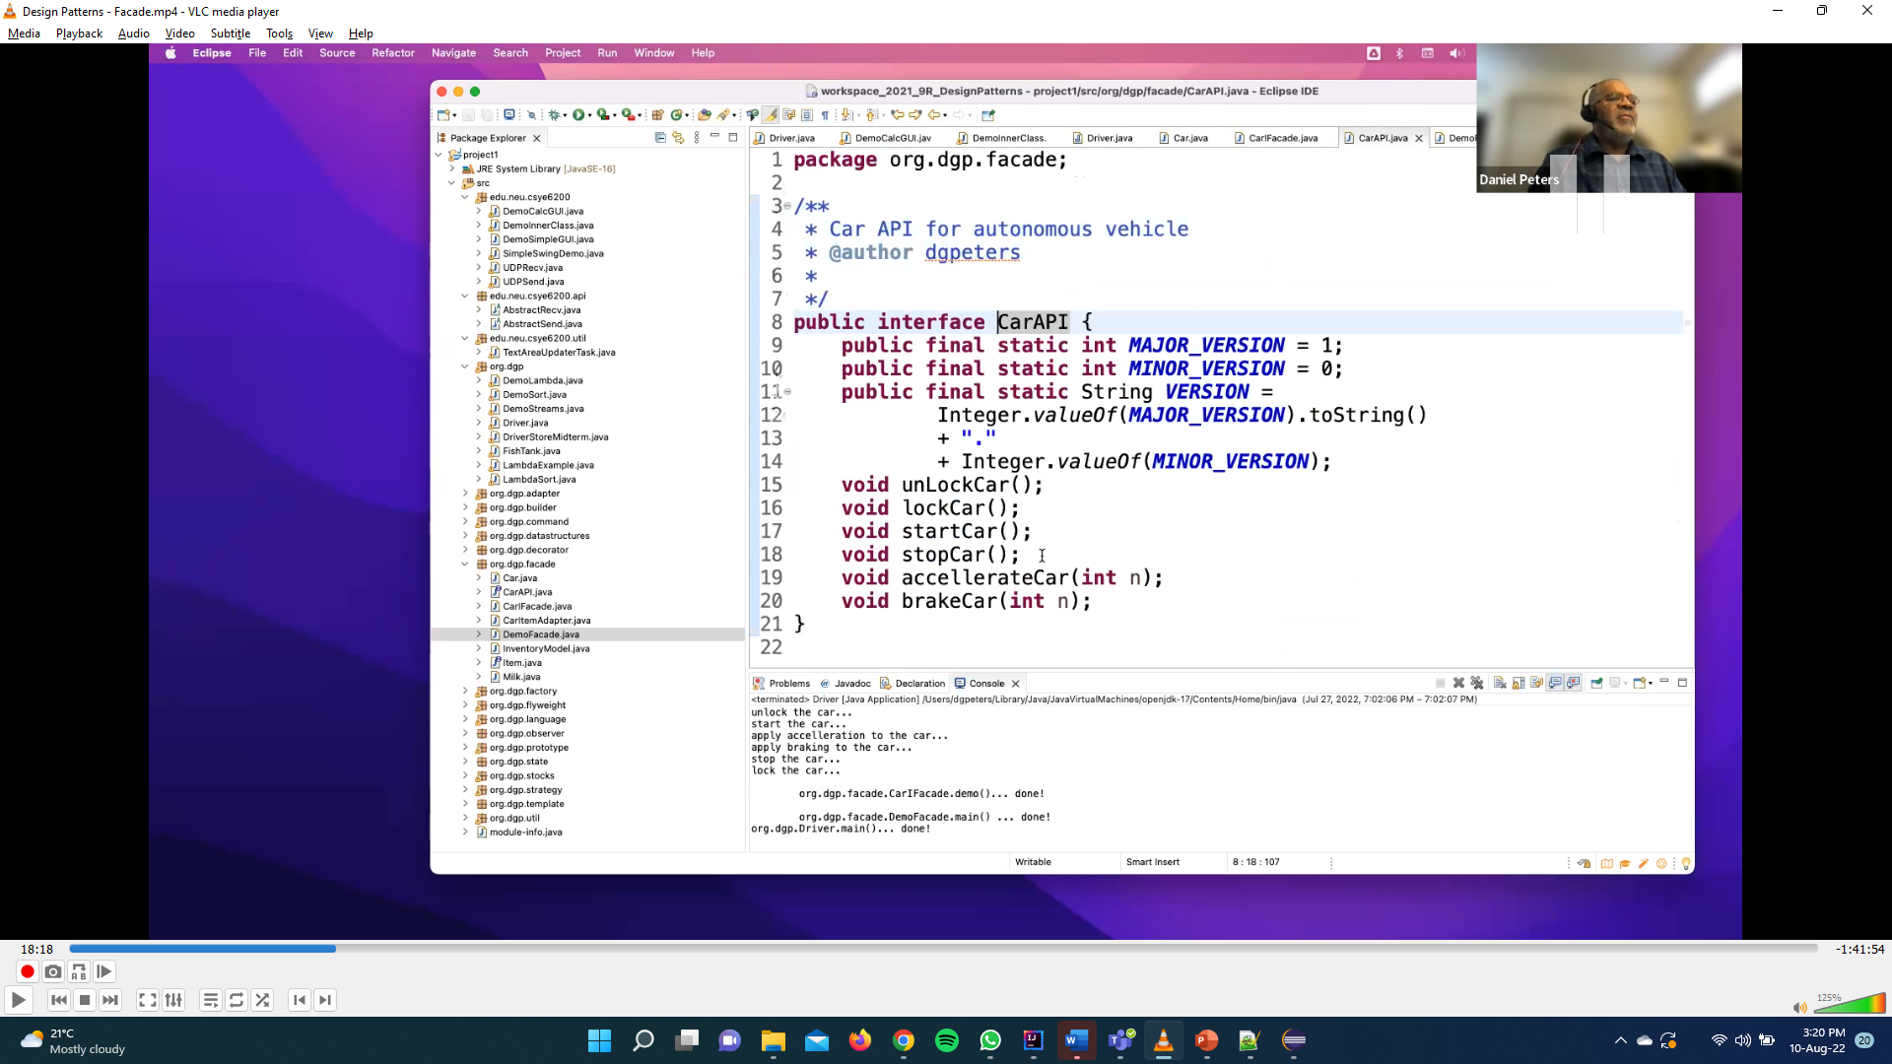

Slide 27
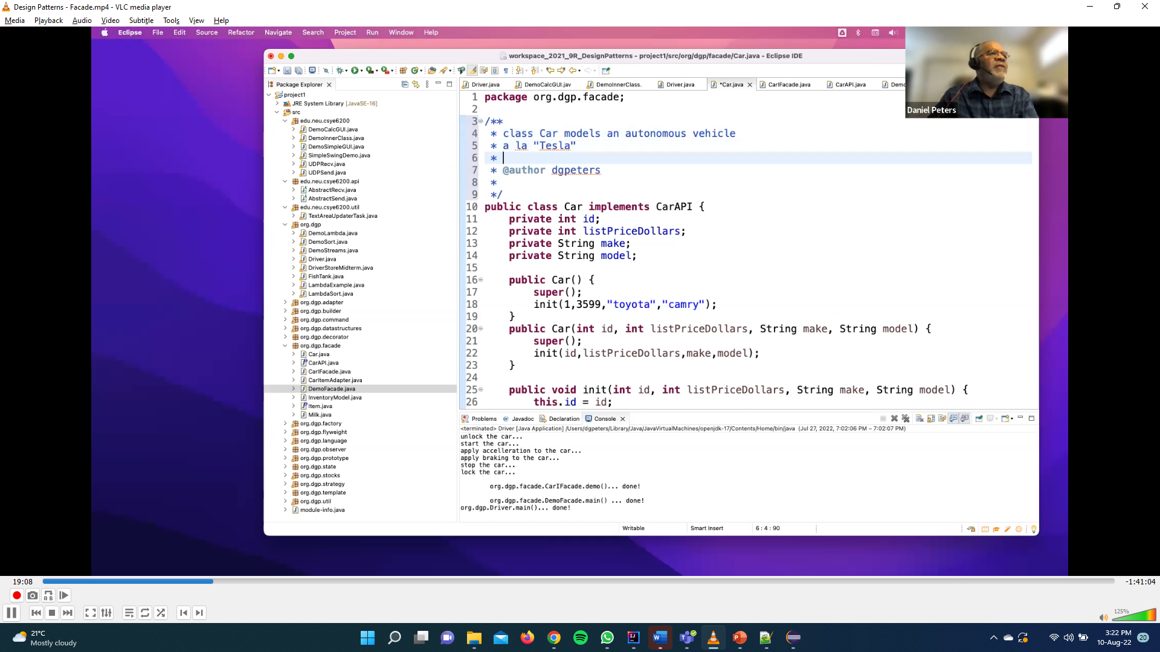

Slide 28
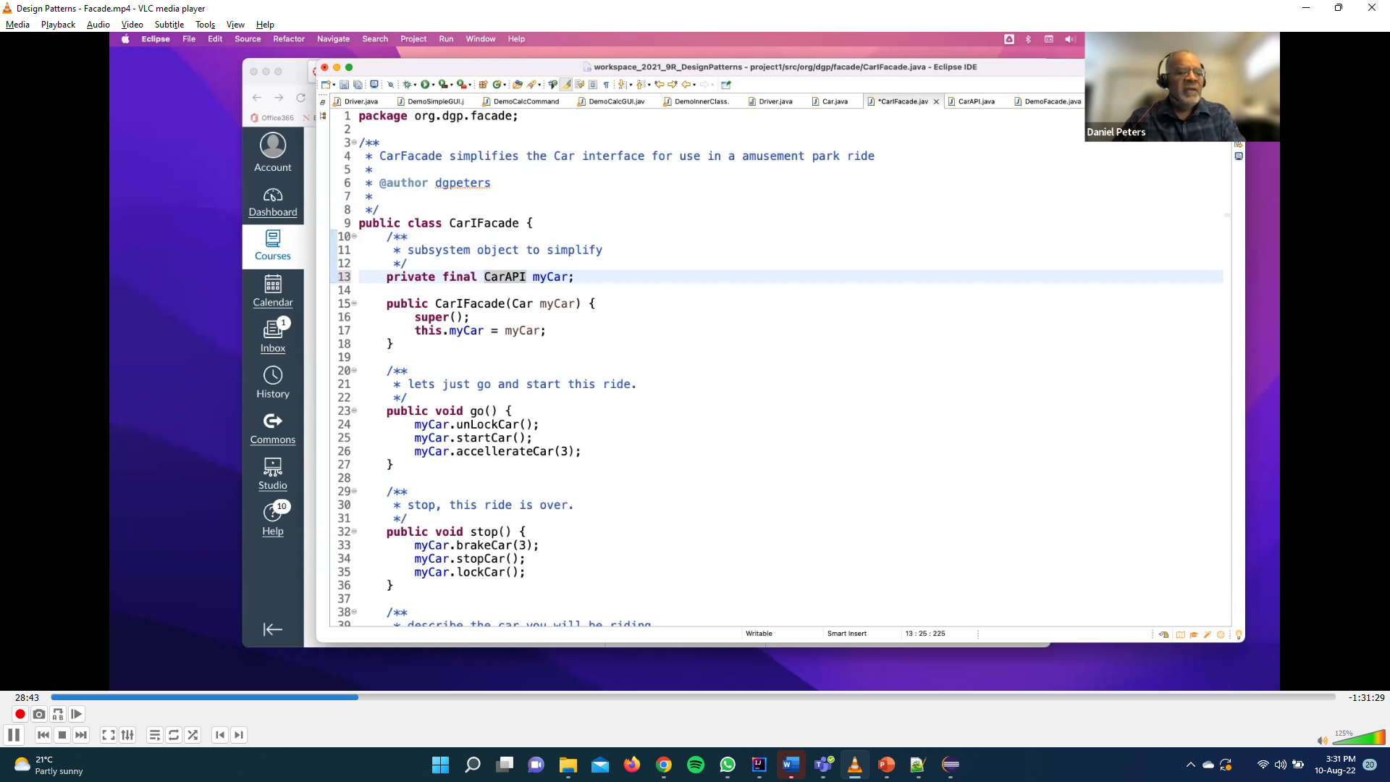

Slide 29
